Slide 1
REF and research funding update
Steven Hill
Head of Research Policy
Astronomy Forum
03 February 2015

Slide 2
Summary
Research Excellence Framework
Outcomes
Evaluation and next steps
QR Funding

Slide 3
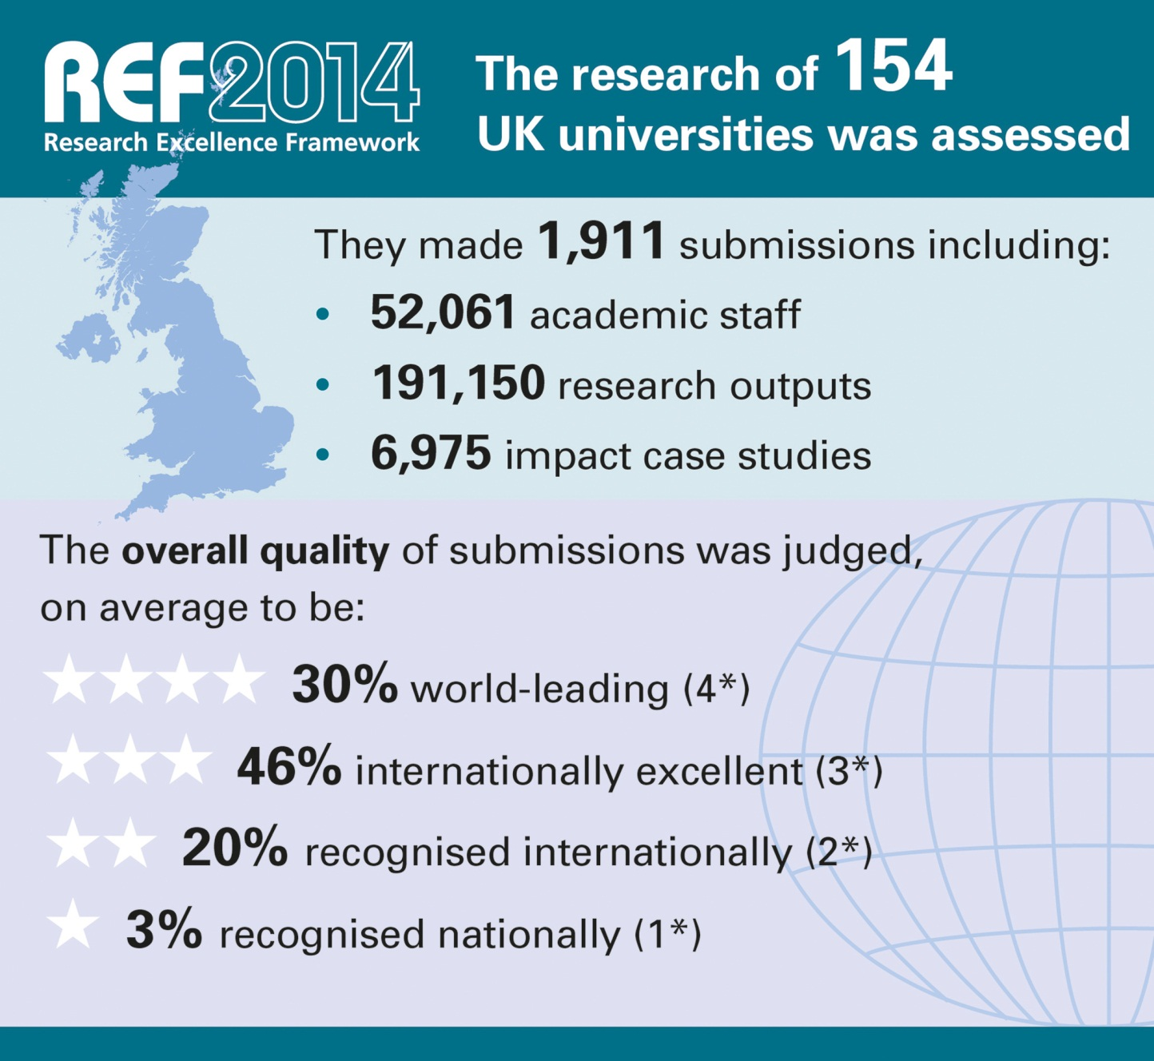
Notes:
The primary outcome will be an overall quality profile for each submission, this will show the proportion of research judged to meet each of the four starred quality levels and will indicate the (FTE) number of staff in each submission
The funding bodies intend to use the assessment outcomes to inform the selective allocation of their research funding to HEIs, with effect from 2015-16; as Graeme said, ~£2 billion per year.
We will also publish all submissions in spring 2015. We will remove personal and contractual details. HEIs may also redact textual parts of their submission which should be excluded for reasons of commercial sensitivity or security
As Vicky Said, submitting HEIs must also produce a Code of Practice on the selection of staff for the REF, these COPs will also be published at the end of the exercise.
Back to Graeme to wrap up.

Slide 4
World-leading quality was found in diverse submissions and institutions across the UK
Submissions from the 154 institutions ranged from 3 staff in a single subject to over 2,500 staff in 32 subjects
The top quarter have at least 30 per cent of their work graded as world-leading (4*).
Three-quarters have at least 10 per cent of their work graded as world-leading (4*).

Slide 5
Differentiation between institutions resulted from all three elements

Slide 6
The quality of UK research has improved significantly since the previous exercise
22% of outputs were judged world-leading (4*), up from 14% in the 2008 RAE
50% were judged internationally excellent (3*), up from 37% in the 2008 RAE

Slide 7
REF confirms other evidence about the improved international performance of UK research
Subject reviews by learned societies and other funders, and national comparisons based on citations show similar improvement

Slide 8
Outputs by early career researchers and staff with other circumstances were found to be of equally high quality to other staff

Slide 9
Outputs identified by institutions as interdisciplinary* were graded equally to other outputs
* Note that these represent a small proportion of interdisciplinary work that was submitted

Slide 10
Excellence was found in all types of research output

Slide 11
Average profiles by main panel

Slide 12
For the first time, REF has demonstrated the impact of UK research in all subjects
Over 250 research users judged the impacts, jointly with academic panel members.
44% of impacts were judged outstanding (4*). A further 40% were judged very considerable (3*).
Impressive impacts were found from research in all subjects.
REF shows many ways in which research has fuelled economic prosperity, influenced public policy and services, enhanced communities and civic society, enriched cultural life, improved health and wellbeing, and tackled environmental challenges.

Slide 13
Impressive impact was found across institutions with submissions of all sizes

Slide 14
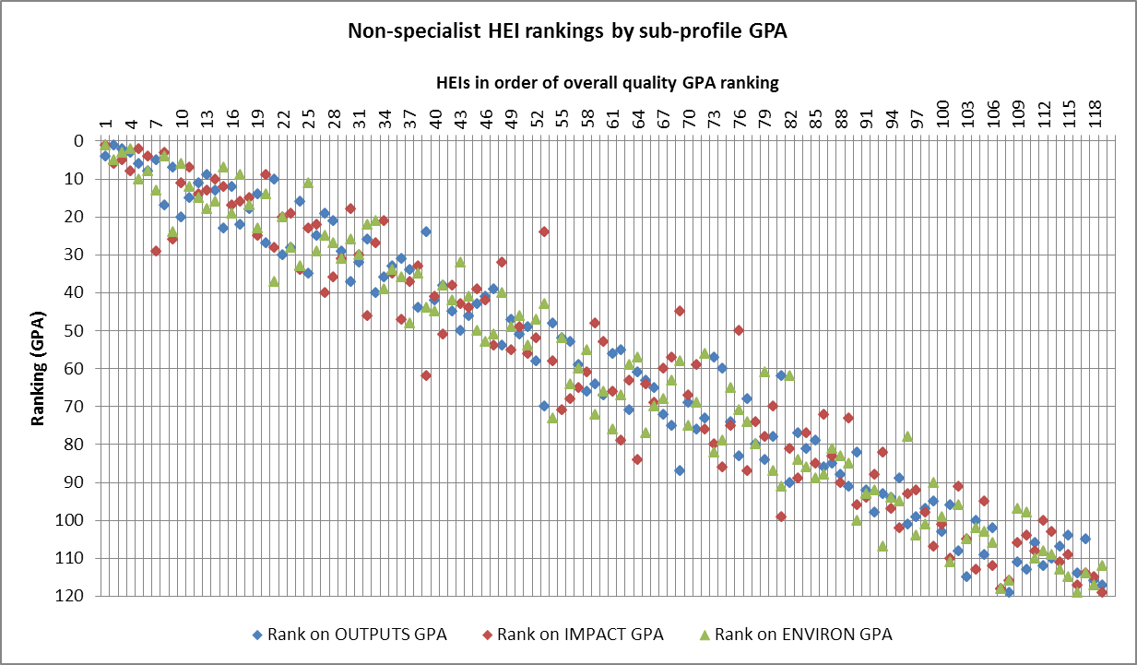
Impact and other scores related, but not perfectly

Slide 15
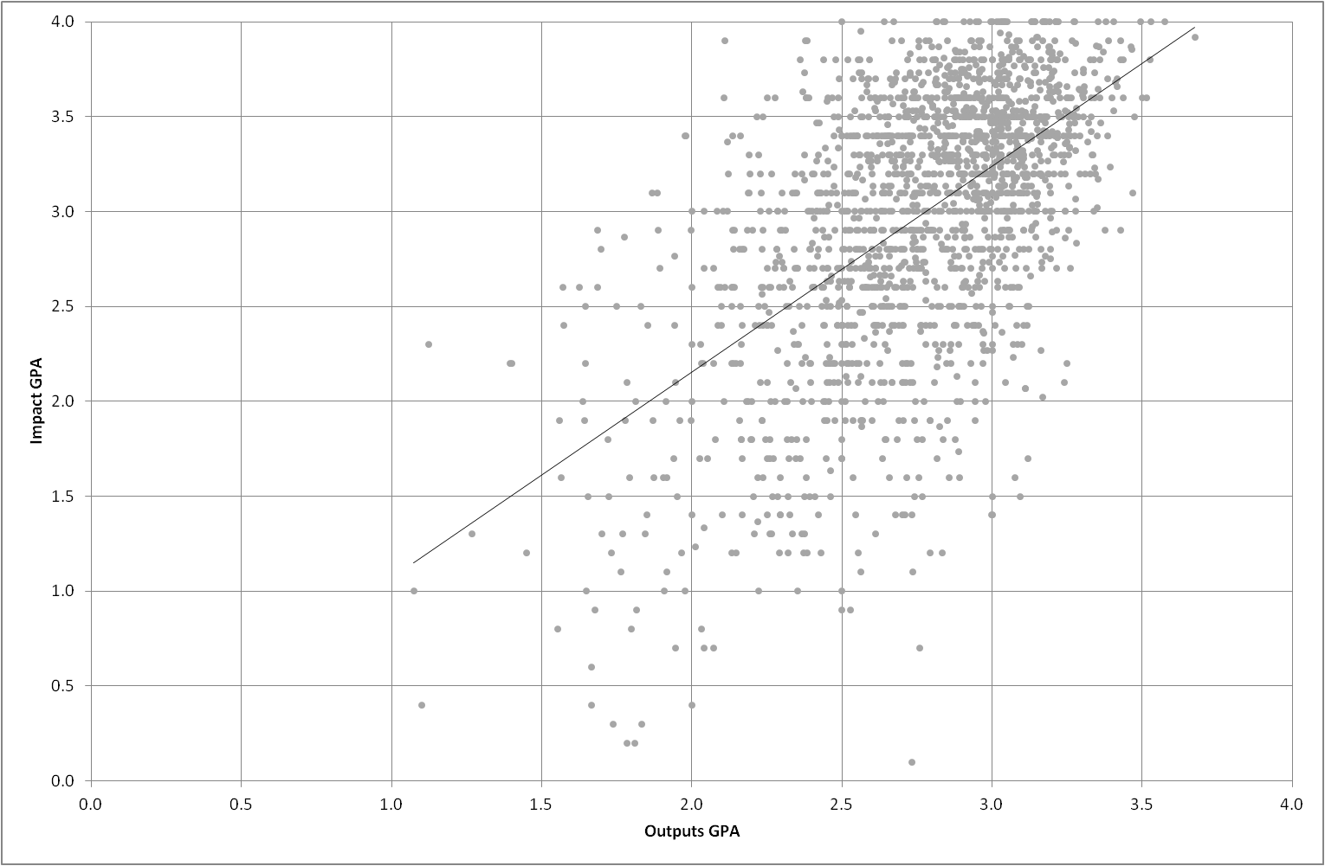
Impact and other scores related, but not perfectly

Slide 16
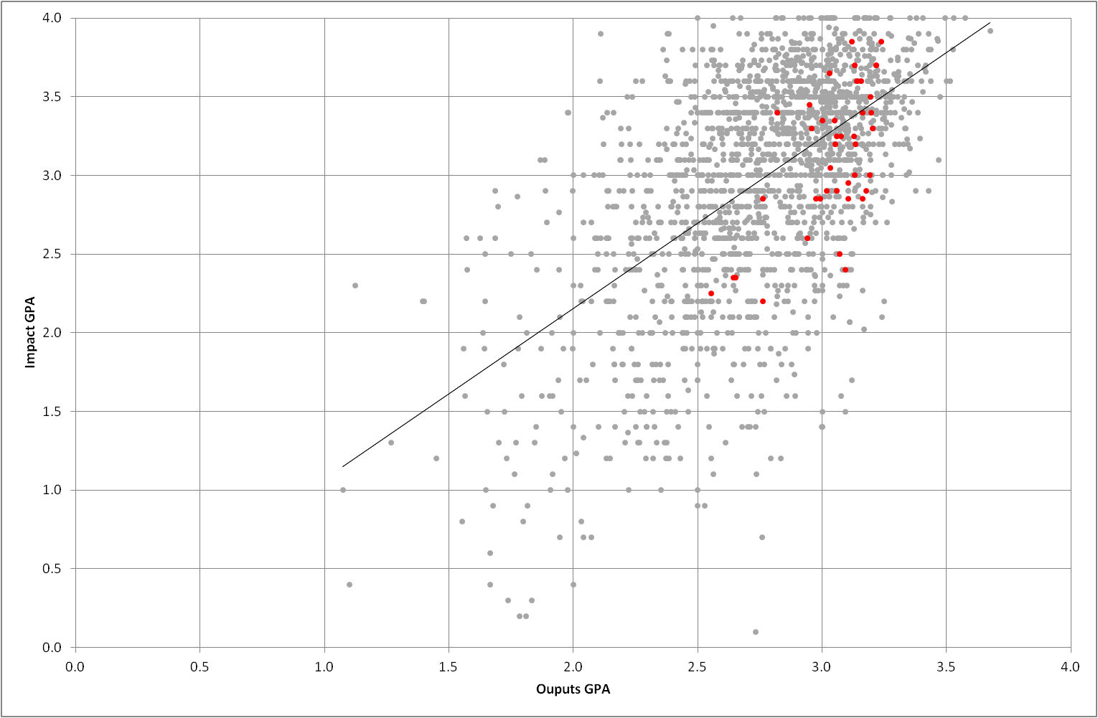
Impact and other scores related, but not perfectly

Slide 17
REF evaluation and analysis
Impact evaluation: phase 1 (submissions), phase 2 (assessment)
Impact case study analysis
Cost of REF2014
HEI feedback
Panel member feedback
Multi- and inter-disciplinary research
High performing UoAs

Slide 18
QR funding
FY 15/16 is a 'transitional' year
Key principles remain:
Selective on the basis of quality
Excellence wherever it is found
Reflect cost of disciplines
Transparent allocation approach

Slide 19
Thank you for listening
s.hill@hefce.ac.uk
@stevenhill

