Slide 1
STFC presentation
Town Meetings March-April 2016
John Womersley
STFC
Notes:
John on behalf EB
Xth leadership conference
1st felt trying to pull everyone together
Long past that, now

Slide 2
Welcome!
STFC science continues to deliver outstanding successes
Notes:
The first year of Run 2 of the LHC at 13 TeV finished with ATLAS and CMS each collecting some 4 fb⁻¹ of proton-proton collisions (more than feared, less than originally promised).
The run ended with a successful lead-lead heavy ion run. With more data, the very high-mass electron pair seen earlier looked less significant.
There has been some excitement from ATLAS in the observation of an excess in photon-photon events at 750 GeV. The CMS collaboration also see hints of something at the same mass. Only more data will reveal whether this is new physics or a statistical fluctuation.
The recommissioned experiments have performed superbly, although CMS continues to have serious problems with its solenoid.
Other news
Although the MICE collaboration continues to wrestle with magnet problems, there has been good progress in last few months:
The many components have been commissioned and data taking is now a regular feature. In autumn this year measurements were made for the first time with field in the upstream spectrometer solenoid. This data will form the basis of a publication on the measurement of emittance in the MICE experiment.
The team in the US have successfully operated an RF cavity at high gradient in a magnetic field. This validates one of the major design challenges in the MICE experiment.
Two of the three superconducting magnets have been fully trained to operating current +2% and soak tested, they are now considered fully commissioned.

Slide 3
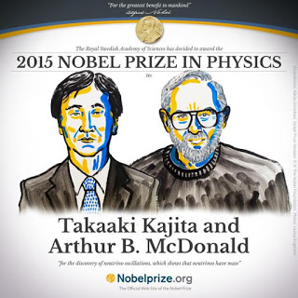
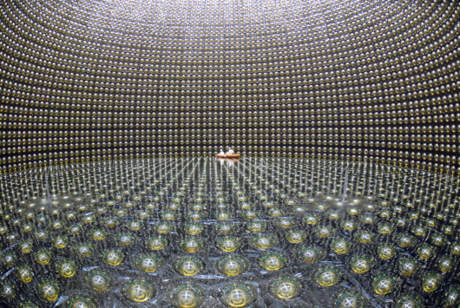
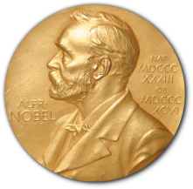
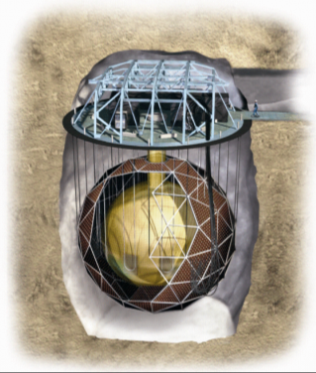
Nobel Prize for neutrino oscillations
Neutrino oscillations demonstrate that neutrinos have mass – physics beyond the Standard Model!
Leads onto the future programme with Hyper-K and DUNE
UK was a major player in Sudbury Neutrino Observatory, contributing water systems, concentrators, offline software, and key algorithms used to separate signals from backgrounds
Notes:
The big excitement this Autumn has been in the recognition of Neutrino Physics.
Firstly the Nobel Prize was awarded to leaders of the SNO and Super-Kamiokande experiments for their definitive measurements of neutrinos, confirming the existence of their mass.
The UK was a major player in SNO contributing water systems, the concentrators, the offline software, and the key algorithms used to separate signals from backgrounds. As one of the team leaders, Prof David Wark was invited to Stockholm for the award ceremony.

Slide 4
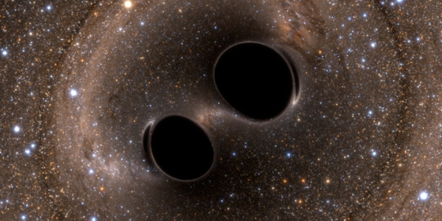
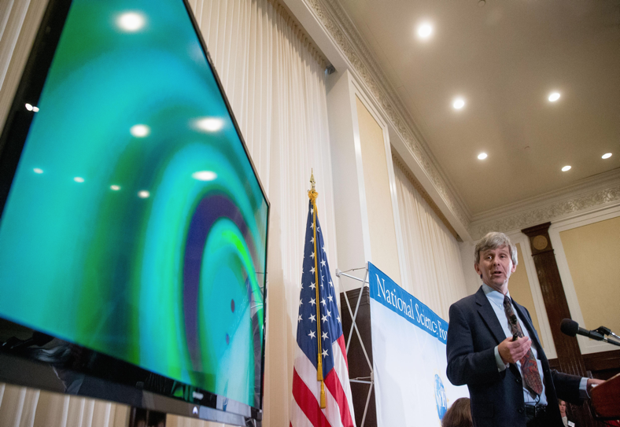
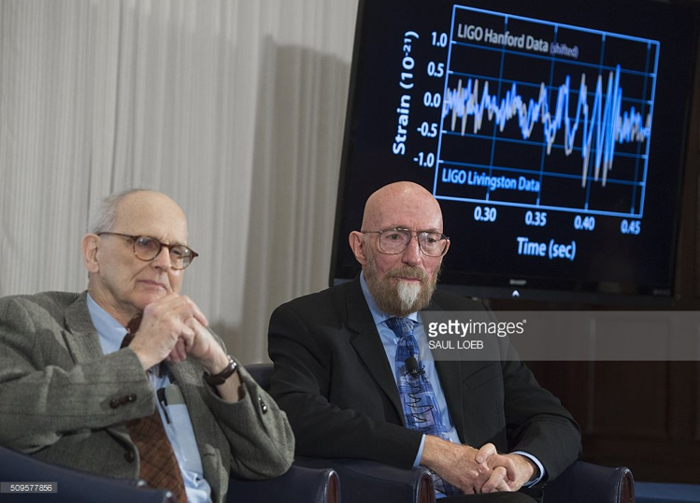
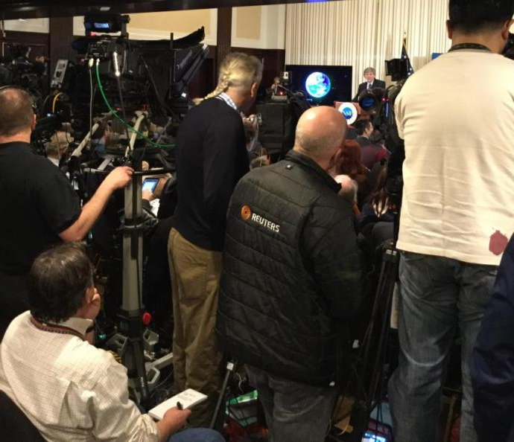
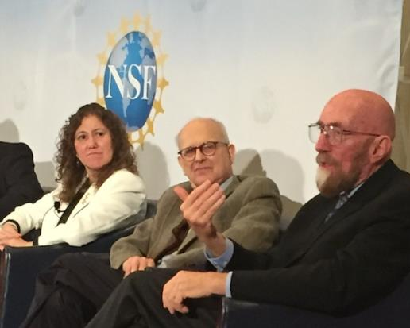
Discovery of Gravitational Waves
NSF Press Conference
Washington, February 11th

Slide 5
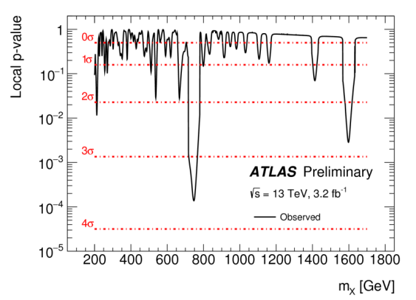
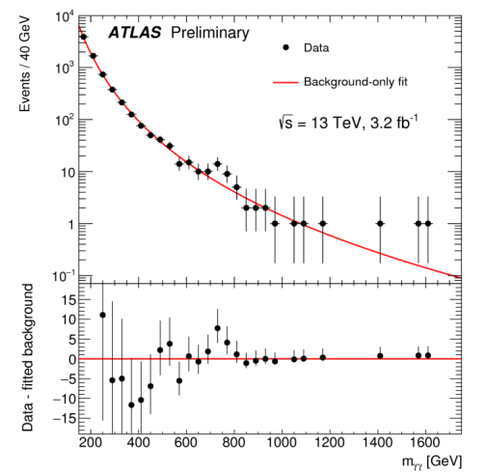
Who knows…
ATLAS
γγ resonance at 750 GeV ?
Allowing for ‘look-elsewhere effect’, significance ~2σ
CMS
hints at the same mass
Observation may possibly be explained by known backgrounds
Invariant mass of two photons
Notes:
The first year of Run 2 of the LHC at 13 TeV finished with ATLAS and CMS each collecting some 4 fb⁻¹ of proton-proton collisions (more than feared, less than originally promised).
The run ended with a successful lead-lead heavy ion run. With more data, the very high-mass electron pair seen earlier looked less significant.
There has been some excitement from ATLAS in the observation of an excess in photon-photon events at 750 GeV. The CMS collaboration also see hints of something at the same mass. Only more data will reveal whether this is new physics or a statistical fluctuation.
The recommissioned experiments have performed superbly, although CMS continues to have serious problems with its solenoid.
Other news
Although the MICE collaboration continues to wrestle with magnet problems, there has been good progress in last few months:
The many components have been commissioned and data taking is now a regular feature. In autumn this year measurements were made for the first time with field in the upstream spectrometer solenoid. This data will form the basis of a publication on the measurement of emittance in the MICE experiment.
The team in the US have successfully operated an RF cavity at high gradient in a magnetic field. This validates one of the major design challenges in the MICE experiment.
Two of the three superconducting magnets have been fully trained to operating current +2% and soak tested, they are now considered fully commissioned.

Slide 6
Welcome
STFC science continues to deliver incredible success
Gravitational waves and Nobel Prize for Neutrino Oscillations
‘Exceptional intrinsic value’ – Select Committee visit to CERN
And the promise of future excitement . . .
… and great impact too
New cancer treatments
Environmental breakthroughs
Inspiring hundreds of thousands of young people
We should celebrate that success, but time is short, so I will focus today on two issues:
The implications of the Comprehensive Spending Review implications and what we need to do together as a result
Nurse Review and what you as a community can do
Notes:
In September 2014, CERN tuned 60 and celebrated peaceful collaboration for science
In 2014, 614 UK particle physicist carried out research at CERN.

Slide 7
Comprehensive Spending Review
May 2015
Research Councils asked to describe the impact of potential scenarios
+20% / flat + inflation / flat / -25%
RCs also asked to highlight untapped demand and strategic priorities
July - September 2015
Asked to describe the impact of a refined range of scenarios
-25% / -10% / -5% / flat / flat + inflation
External revenue sources, ODA, security and defence alignment etc
Notes:
In September 2014, CERN tuned 60 and celebrated peaceful collaboration for science
In 2014, 614 UK particle physicist carried out research at CERN.

Slide 8
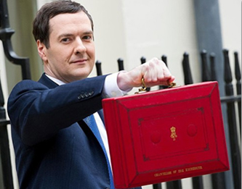
25 November 2015
Chancellor announced headline numbers
Pledged to protect science in real terms
Science budget included Research Councils, HEFCE, Innovate UK, UK Space Agency, academies
New £1.5 billion science ODA fund
Notes:
In September 2014, CERN tuned 60 and celebrated peaceful collaboration for science
In 2014, 614 UK particle physicist carried out research at CERN.

Slide 9
Comprehensive Spending Review
November 2015 – February 2016
Intensive negotiation with BIS by all Research Councils
Not easy for BIS team – trying to do the best thing for science but tough to balance the books
STFC submitted extensive financial information and narratives
Asked for revised versions of the -10% and flat cash scenarios
STFC also submitted minimum viable scenarios
Provided a lot of detail against all funding lines e.g. international subscriptions, facilities, postgraduate training, research funding
STFC’s narratives were clear on implications of each scenario
Notes:
In September 2014, CERN tuned 60 and celebrated peaceful collaboration for science
In 2014, 614 UK particle physicist carried out research at CERN.

Slide 10
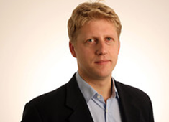
4 March 2016
Jo Johnson announced high level numbers for each Research Council, UKSA, HEFCE and National Academies
Met Chancellor’s promise: total science budget protected against inflation
STFC received £2,082 million in resource and capital allocation over four years 2016-20
2016-17 and 2017-18 are firm allocations – the rest are indicative pending the implementation of the Nurse Review
Means a SR in 2017 to establish budgets for 2018 onwards
Notes:
In September 2014, CERN tuned 60 and celebrated peaceful collaboration for science
In 2014, 614 UK particle physicist carried out research at CERN.

Slide 11
Allocation of science funding
Allocation booklet not entirely clear
STFC’s funding was not announced by funding partition – can confirm the partitions still remain
Capital listed under two headings
“World Class Labs” which roughly covers existing capital
“Grand Challenges” not itemised but covers new capital projects
Research Councils have secured a lot of money but we do have challenges
Pressures mean that Research Councils received roughly flat cash for their core programmes through combination of resource funding and Global Challenges
£700m of Global Challenges Research Fund (GCRF) remains unallocated between 17/18 and 20/21
Must be ODA compliant so some clever thinking will be required

Slide 12
RCUK strategic priorities booklet
RCUK published its strategic priorities on 18th March
Included revised financial tables with partitions
Each Research Council set out its own high-level spending plans in a two-page appendix
STFC’s include pledges to deliver, amongst others:
An excellent programme in particle physics, nuclear physics and astronomy
CERN, ESO, ESRF, ILL and FAIR, plus CERN technical upgrades, E-ELT and LSST
New commitments: ESS, XFEL and SKA
Operate and upgrade Diamond, ISIS and CLF
Increase innovation output from our funded activities
Skills programme to link traditional STEM with software engineering, technology development, and data science
Strong programme of public engagement
Notes:
In September 2014, CERN tuned 60 and celebrated peaceful collaboration for science
In 2014, 614 UK particle physicist carried out research at CERN.

Slide 13
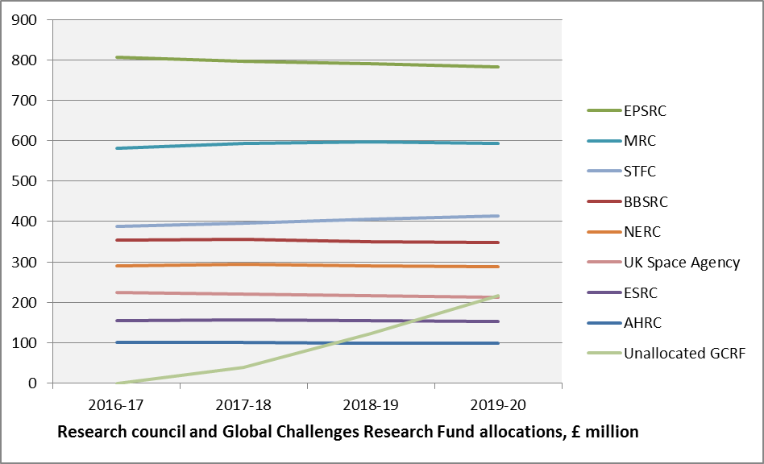
Research Council allocations
Indicative
Times Higher Education table
GCRF = funding for research into global challenges Has to meet ODA rules

Slide 14
STFC allocation in detail
£M | 2015-16 | 2016-17 | 2017-18 | 2018-19 | 2019-20
 |  | Allocated |  | Indicative
Resource
International Subscriptions | 127.5 | 114.3 | 118.2 | 127.0 | 133.9
UK National Facilities | 107.4 | 107.7 | 108.2 | 109.1 | 110.1
Core Programme | 165.1 | 166.1 | 166.1 | 166.1 | 166.1
GCRF |  |  | 3.5 | 3.5 | 3.5
Capital
International Subscriptions | 27.3 | 81.6 | 99.3 | 103.6 | 95.9
UK National Facilities | 48.5 | 45.4 | 38.8 | 45.2 | 46.1
Core Programme | 69.3 | 94.1 | 62.8 | 64.8 | 41.8
Notes:
In September 2014, CERN tuned 60 and celebrated peaceful collaboration for science
In 2014, 614 UK particle physicist carried out research at CERN.

Slide 15
What it means for STFC
Overall position
Partitions have been retained
Another 4 years of flat cash will obviously impact the volume of the programme
BIS worked with us to address specific issues
Core
Resource: flat from 2016-17 onward
Capital: flat for first three years, reduced in final year
International subscriptions
Resource: sufficient for existing and new commitments - SKA, ESS and XFEL
Capital: sufficient for existing and new commitments
Facilities
Resource: inflation indexed but need for efficiencies and/or generate additional revenue in later years
Capital: inflation indexed
Notes:
In September 2014, CERN tuned 60 and celebrated peaceful collaboration for science
In 2014, 614 UK particle physicist carried out research at CERN.

Slide 16
Science Board input
Already planned a balance of programme exercise this year for the PPAN programme
Exact form of this review to be discussed at April Science Board meeting
Likely a sub-group of Science Board including appropriate non core members to get the correct expertise
Will include consultation with community
Probably via Advisory Panels
Not same process as in the previous programmatic reviews, we may well wish to ask more targeted questions

Slide 17
Global Challenges Research Fund
£3.5m p.a. allocated to STFC - will be managed by our Programmes Directorate
Needs to fund ODA compliant activities
£700m of GCRF yet to be allocated until 2021 with £38m for 2017/18 alone
Also (separately) there will be an extension and significant uplift in the Newton Fund
Programme still being designed
Seems likely to be a single central pot held in RCUK with funding flowing direct to researchers rather than via STFC
Call(s) likely later in 2016 for spend to start in 2017/18

Slide 18
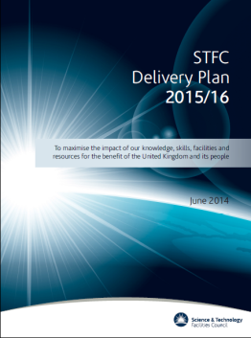
What next?
Engagement with BIS and RCs on Large Facilities
Community meetings from end of March
Particle Physics IOP meeting 23/3
Nuclear Physics IOP meeting 31/3
RAS Astronomy forum 7/4
Particle Beams IOP meeting 8/4
STFC Staff Forums from 11 April
Starting to work up our Delivery Plan –publication
2016/21
Finalise our Corporate Strategy – publication after July

Slide 19
Nurse Review
Key recommendation
New NDPB provisionally called Research UK
To contain all 7 research councils plus the QR part of HEFCE and probably Innovate UK
RUK would have one CEO who would be accounting officer for the whole science budget
Nurse himself now has no special role in the process
“Policy Reform” now moved to the top of the agenda in BIS but lots of competing agendas coming into play
High-level legislation likely to be initiated this year
Will appear in the Queen’s Speech with White Paper following soon after
RUK “organisational design” will take until 2018

Slide 20
How you can help
Looking for members of our panels and advisory committees
Still a lot of ODA money on the table
Newton Fund is doubling in size – separate money
Need to convince BIS (and/or RCUK) how your science can contribute to ODA
Need to be cleverer in identifying ways to access this and other external income
Engage on Research UK/Nurse:
Not likely any further formal consultation
Hopefully a lively debate
Ideally stress need to properly support scientific infrastructure, international facilities and long term strategic research programmes

Slide 21
…and just one more thing

Slide 22
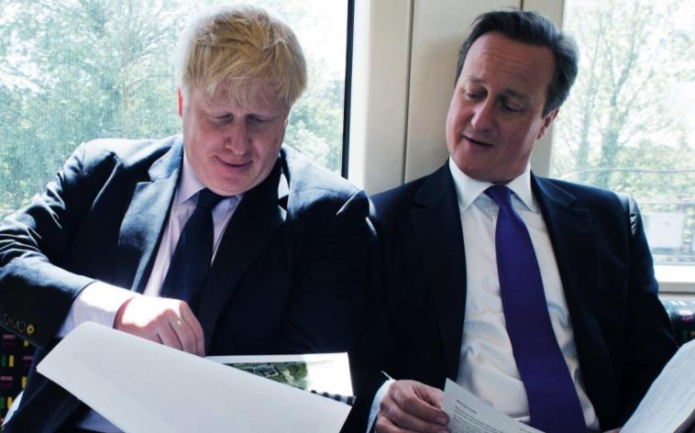
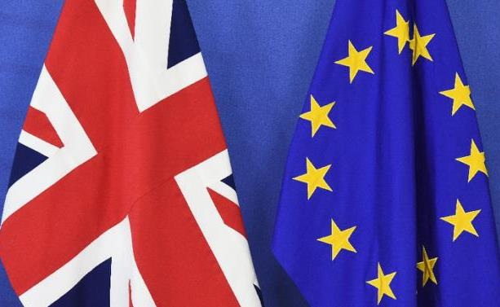
Brexit
CERN, ESRF, ILL, ESO, SKA and XFEL are all intergovernmental agreements, not part of the EU
ESS is an ERIC (an EU legal structure)
STFC itself does not receive much EU H2020 funding (few €m/yr)
But if course many universities more dependent on e.g. ERC
Biggest short term exposure to STFC is impact of £/€ on international subscriptions
Biggest long term impact probably on ability to recruit

Slide 23
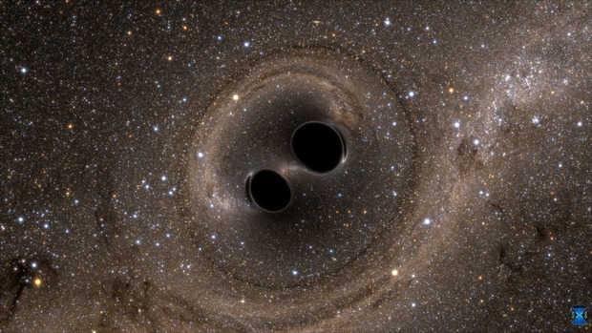
Discussion

